Slide 1

C
e
G
a
e
r
r
o
.
Department of Computer Science and Engineering College of Engineering Thalassery
TEAM MEMBERS –
TLY21CS055 – Shebin Shamsuddeen
TLY21CS041 – Muhammed Nibras
TLY21CS043 – Muhammed Suhail
TLY21CS067 - Muhammed RM
Guide -
Prof. Reni
Assistant Professor
Group 10 Final Review

Slide 2
e
n
C
n
t
o
t
s
Abstract
Introduction
Problem Definition
Objectives
Proposed System
Requirement Specification
Feasibility Study
Architecture Diagram
Use Case Diagram
Data Flow Diagram
Methods and Techniques
Literature Survey
Interfaces and Layouts
FrontEnd,BackEnd,Model
Conclusion
References

Slide 3
A
s
b
r
t
t
c
a
Introducing a website which helps Computer Science students choose their career path
Our website will be using machine learning algorithms like K-Nearest Neighbours , Decision trees , SVM etc .
The goal is to help individuals make better career choices using data analysis and AI-based recommendations
01

Slide 4
INTRODUCTION.
02

Slide 5
d
o
t
I
c
o
u
n
n
t
i
r
Choosing the right career path is a critical decision for students, especially in a dynamic field like computer science.
Traditionally , these system rely on manual counselling or standardized tests
Based on these tests , career options will be recommended
03

Slide 6
i
i
o
n
e
f
n
i
b
D
t
P
l
r
o
e
m
Many computer science students struggle to identify suitable career paths due to limited awareness of available opportunities.
This often leads to confusion and misaligned career choices.
There is a need for a recommendation system that is tailored for Computer Science students
04

Slide 7
S
e
m
p
o
f
y
s
t
S
c
e
o
The system is designed to assist computer science students in discovering career paths that align with their individual skills, interests, and goals.
It covers a broad range of fields including Artificial Intelligence, Data Science, Cybersecurity, Web Development, and more.
With a user-friendly interface and intelligent backend, the platform ensures accessible and accurate career recommendations for every user.
05

Slide 8
O
e
c
v
e
b
j
i
s
t
Use ML for personalised career suggestions
Customize career suggestions based on personality traits
Making career counselling easy and accesible
Provide instant feedback
06

Slide 9
y
s
e
m
P
p
o
d
S
t
r
o
s
e
The proposed system is a web-based platform that collects user data through an interactive questionnaire and analyzes it using machine learning algorithms.
Based on the user’s responses, the system predicts and suggests career paths best suited to their profile.
Displays a ranked list of career options based on model prediction, including job roles, required qualifications, and skillsets.
07

Slide 10
e
i
n
r
m
e
f
o
R
t
i
p
c
i
a
t
n
c
e
u
e
S
q
i
Function Requirements
User Registration/Login
Profile Management
Flexible Questionnaire
Career Recommendations
08

Slide 11
e
i
n
m
e
f
o
R
t
i
p
c
i
a
t
n
c
e
u
r
e
S
q
i
Non - Function Requirements
Performance
Scalability
Security
Usability
Compatibility
09

Slide 12
u
y
i
S
t
d
F
l
t
y
e
s
b
i
a
i
Technical Feasibility -
In this application python and machine learning is technically feasible because it is simple ,easy to understand and it is help to time consumption
Operational Feasibility -
The project is operationally feasible because it fits current career counseling trends, uses accessible technology, and can be managed by a small, skilled team
10

Slide 13
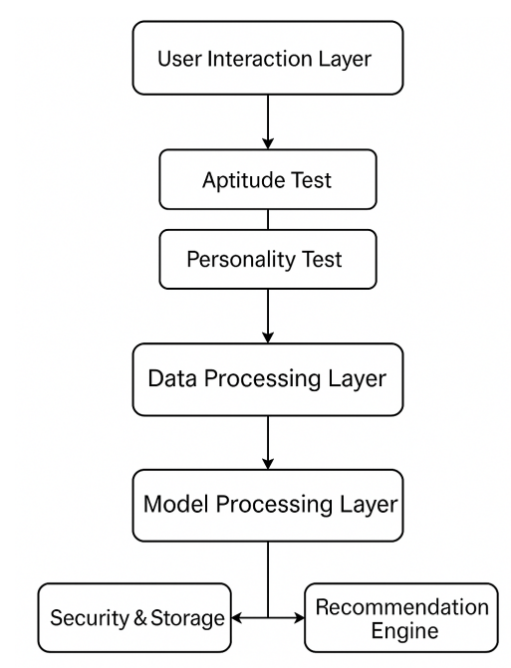
D
i
t
a
g
A
e
t
u
r
r
m
r
h
i
c
e
a
c
11

Slide 14

a
C
e
U
e
s
s
Register / Login
Complete Questionnaire
Receive Recommendation
User
Admin
Provide Feedback
Manage Users
Analyse user feedback
12

Slide 15
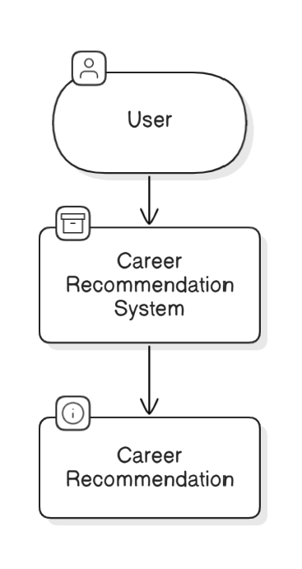
a
D
F
i
a
D
t
w
m
a
a
l
o
r
g
Level 0 DFD
13

Slide 16
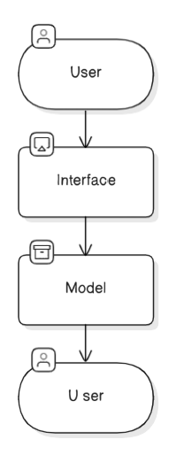
a
D
F
i
a
D
t
w
m
a
a
l
o
r
g
Level 1 DFD
14

Slide 17
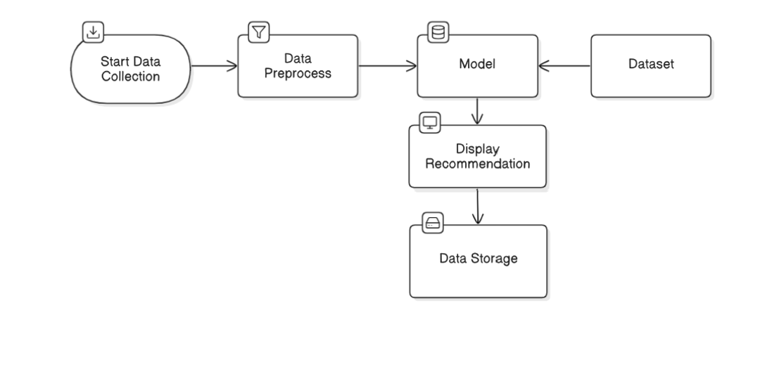
a
D
F
i
a
D
t
w
m
a
a
l
o
r
g
Level 2 DFD
15

Slide 18
d
n
q
u
e
s
M
e
t
h
o
s
T
e
c
h
i
&
Python for building the machine learning models
React.js for designing the user interface, allowing users to input their data and receive recommendations
Node.js for backend development, managing data flow between the frontend and the machine learning engine.
16

Slide 19
Literature Survey.
17

Slide 20
p
1
P
e
a
r
An Intelligent Career Guidance System using Machine Learning
AUTHORS
Dahanke Ajay
Shinde Nilesh
Dhagate Anirudh
Shaikh Huzaif
BRIEF SUMMARY
This paper introduces a web-based application aimed to beat the traditional career guidance processes and methods
Involves the use of machine learning algorithms to work out the simplest possible career pathway
18

Slide 21
p
1
P
e
a
r
An Intelligent Career Guidance System using Machine Learning
Methodology
Data Collection: The system collects students' top two subject marks and assesses their skills through an online test.
Skill Assessment Module: Students undergo a psychological and core skills-oriented test. Technologies like HTML5, CSS3, and JavaScript are used for the front-end, while JavaScript handles validation.
Prediction Module:
K-Nearest Neighbors (KNN) is used for classification, mapping students to appropriate career streams.
Result Analysis: The model performance is evaluated using a confusion matrix, calculating accuracy, precision, recall, and error rate.
19

Slide 22
p
1
P
e
a
r
An Intelligent Career Guidance System using Machine Learning
Advantages
User-friendly
Cost-efficient
Enhanced accuracy
Real-time feedback
Reduces failure rates
Disadvantages
Limited by Data
Subjective Testing
No human interaction
20

Slide 23
p
2
P
e
a
r
A Survey on Machine Learning Approaches and Its Techniques
AUTHORS
Thomas. Rincy. N
Dr. Roopam Gupta
BRIEF SUMMARY
This paper provides an overview of various machine learning (ML) approaches and their techniques, such as supervised, unsupervised, semi-supervised, and reinforcement learning.
Machine learning helps systems make decisions and predictions from data. The paper explores different ML approaches
21

Slide 24
p
2
P
e
a
r
A Survey on Machine Learning Approaches and Its Techniques
Methodology
The paper reviews the theoretical foundations of each machine learning approach and presents several well-known algorithms used for each type
The study uses diagrams to illustrate the classification of algorithms, showing the progression from supervised learning to more advanced forms like reinforcement learning.
22

Slide 25
p
2
P
e
a
r
A Survey on Machine Learning Approaches and Its Techniques
Advantages
Comprehensive Overview
Application Across Domains
Discussion of Classic and Modern Techniques
Disadvantages
Lack of Practical Examples
Limited Focus on Recent Developments
Surface level explanation
23

Slide 26
p
3
P
e
a
r
Online Career Counsellor System based on Artificial Intelligence: An Approach
AUTHORS
Kartikey Joshi
Amit Kumar Goel
Tapas Kumar
BRIEF SUMMARY
This paper introduces a career counseling system aimed at helping students select their ideal career paths based on their skills, interests, and academic performance
The system integrates Artificial Intelligence (AI) techniques like Support Vector Machine (SVM) and Decision Trees to offer career recommendations based on user inputs
24

Slide 27
p
3
P
e
a
r
Online Career Counsellor System based on Artificial Intelligence: An Approach
Methodology
Data Collection: The system gathers user data from multiple sources, including tests and social media APIs, as well as from colleges and employees.
Data Preprocessing : After collection, the data undergoes cleaning, removal of null values, and formatting to make it suitable for machine learning algorithms
Algorithms
Support Vector Machine (SVM): Used for classification and regression, SVM helps identify optimal career recommendations by plotting data and finding the best decision boundary.
Decision Tree: A classification algorithm that uses splits based on entropy and information gain to predict career paths
User Interaction : The platform guides students through levels of questions that gradually narrow down career options based on their responses. After completing the test, students receive personalized advice.
25

Slide 28
p
3
P
e
a
r
Online Career Counsellor System based on Artificial Intelligence: An Approach
Advantages
AI-Powered Recommendations
Scalability
Interactivity
Reduced Time and Cost
Disadvantages
Data Dependency
Limited Human Interaction
Complexity
26

Slide 29
p
4
P
e
a
r
Development of a Web-based Intelligent Career Guidance System for Pre-Tertiary Science Students in Nigeria
AUTHORS
Alao Kazeem
Bolarinwa Ismaila
Kuboye Bamidele
Ibam Onwuka
BRIEF SUMMARY
This paper describes the creation of an online expert system designed to assist science students in choosing appropriate career paths
The system uses a rule-based expert system to provide career recommendations based on three key parameters: students’ favorite science subjects, career interest inventory analysis, and their intelligent quotient (IQ) test results
27

Slide 30
p
4
P
e
a
r
Development of a Web-based Intelligent Career Guidance System for Pre-Tertiary Science Students in Nigeria
Methodology
Data Collection: The system collects data from students through three inputs: favorite science subjects, career interest analysis, and IQ tests (verbal, numerical, and logical reasoning).
Expert System Design
The system is based on a rule-based expert system, with an inference engine matching the inputs to predefined career rules stored in a knowledge base
The forward chaining algorithm is used to evaluate the inputs, matching them against career rules to recommend suitable career paths
Implementation
The system was implemented using HTML5, CSS3, and JavaScript for the front end, while XAMPP was used for the back-end with MySQL as the database.
28

Slide 31
p
4
P
e
a
r
Development of a Web-based Intelligent Career Guidance System for Pre-Tertiary Science Students in Nigeria
Advantages
Accessibility
Efficiency
High Accuracy
Cost-Effective
Disadvantages
Limited Scope
Dependency on Self-Reported Data
Lack of Human Interaction
29

Slide 32
p
5
P
e
a
r
A Study of Data Mining Methods for Prediction of Personality Traits
AUTHORS
Helly. N. Desai
Prof. Rakesh Patel
BRIEF SUMMARY
This paper explores different machine learning approaches—supervised, unsupervised, and semi-supervised methods—for predicting the Big Five personality traits (Openness, Conscientiousness, Extraversion, Agreeableness, and Neuroticism).
The study emphasizes the use of digital footprints such as user demographics, likes, and activities to predict personality traits more accurately
30

Slide 33
p
5
P
e
a
r
A Study of Data Mining Methods for Prediction of Personality Traits
Methodology
Data Collection: Digital footprints (demographics, activities, and likes) are collected using Facebook Graph API.
Data Preprocessing : Cleaning the data by removing unnecessary elements like hashtags, URLs, and mentions.
Feature Extraction : Relevant features from the text are extracted, including semantic and linguistic features.
Feature Selection : The selected features are refined to help predict personality traits.
Personality Traits Prediction : Using different machine learning models (supervised, unsupervised, and semi-supervised), the prediction of the Big Five traits (OCEAN) is made.
31

Slide 34
p
5
P
e
a
r
A Study of Data Mining Methods for Prediction of Personality Traits
Advantages
High Accuracy
Diverse Applications
Integration of Multiple Features
Disadvantages
Data Privacy Concerns
Dependency on Data Quality
Limited to Social Media
32

Slide 35
Papers | Problem Statements | Methodology | Advantages | Disadvantages | Inference
Paper 1: An Intelligent Career Guidance System using Machine Learning | Students struggle to choose a suitable career after higher secondary education. | Uses K-Nearest Neighbors (KNN) for classification and K-Means Clustering | - Web-based, user-friendly interface. - Cost-efficient - Reduces failure rates | -Limited by data quality. - Subjective testing. - Lack of human interaction. | The system offers a practical machine learning approach for career guidance but requires improvement in data quality and personalization to be more effective.
Paper 2 : A survey on machine learning approaches and its techniques | This survey aims to analyze and categorize various machine learning approaches and techniques | The paper reviews the theoretical foundations of each machine learning approach. The study uses diagrams to illustrate the classification of algorithms | -Comprehensive Overview -Application Across Domains -Discussion of Classic and Modern Techniques | -Lack of Practical Examples -Limited Focus on Recent Developments | This paper is a solid introductory survey for understanding the different types of machine learning approaches​
Paper 3: Online Career Counsellor System based on Artificial Intelligence | Students face difficulties in selecting appropriate careers due to lack of awareness and planning.. | Uses Support Vector Machine (SVM) for classification and Decision Trees to recommend careers based on aptitude tests and user preferences | - AI-based, providing personalized career advice. - Scalable and accessible. | - Highly dependent on data quality. - Complexity in maintaining AI algorithms. | AI-based approaches faces challenges in providing emotional support and personal interaction.
Paper 4: Development of a Web-based Intelligent Career Guidance System for Pre-Tertiary Science Students in Nigeria | Pre-tertiary science students need assistance in choosing appropriate career paths based on their interests and IQ. | Employs a rule-based expert system with an inference engine that uses forward chaining to map student inputs (favorite subjects, career interests, IQ) to career recommendations. | - High accuracy (95%) in recommendations - Accessible to students in remote areas. - Cost-efficient and time-saving. | - Limited to science students. - Self-reported data might be biased. - No human interaction for emotional support. | The rule-based expert system is highly accurate but limited to science fields. Expanding its scope can make it more versatile.
Paper 5 : A study of Data mining methods for prediction of personality traits | To improve the prediction of personality traits by analyzing social media data using various data mining methods | Data collected from social media (e.g., Facebook). Uses supervised, unsupervised, and semi-supervised learning techniques for personality prediction | Combines multiple data mining Useful for various applications such as job recommendations | Raises privacy concerns with the use of social media data. Relies on the availability and quality of social media data | Data mining techniques can accurately predict personality traits, but the method is constrained by privacy concerns
33

Slide 36
Papers | Problem Statements | Methodology | Advantages | Disadvantages | Inference
Paper 6 : Automated Career Guidance Using Graphology, Aptitude Test, and Personality Test | To provide automated career guidance by integrating handwriting analysis ,aptitude tests, and personality tests | Three modules: Aptitude test, personality test (MBTI), and handwriting analysis. Integrates these to provide career recommendations. | Provides a comprehensive career recommendation Highly automated and scalable solution | Relies heavily on handwriting analysis, which lacks scientific validation. Career domains are limited to predefined categories | Offers career guidance, though its reliance on handwriting analysis and predefined career domains limits its broad applicability
Paper 7 : A Survey on Machine Learning Approaches and Its Techniques | This survey aims to analyze and categorize various machine learning approaches and techniques | The paper reviews the theoretical foundations of each machine learning approach. The study uses diagrams to illustrate the classification of algorithms | -Comprehensive Overview -Application Across Domains -Discussion of Classic and Modern Techniques | -Lack of Practical Examples -Limited Focus on Recent Developments | This paper is a solid introductory survey for understanding the different types of machine learning approaches​
Paper 8 : Personality Classification System using Data Mining | Addresses the challenge of classifying human personality traits based on the Big Five Personality traits | - Data Collection - Personality Prediction Algorithms including Naïve Bayes Algorithm and Support Vector Machine (SVM) - Result Interpretation | - Automation Increased Accuracy Scalability | Limited to Big Five Traits Dependent on Data Quality Dependent on Data Quality | Provides system that classifies human personality based on the Big Five Personality Traits using data mining techniques
Paper 9 : Student Career Prediction Using Advanced Machine Learning Techniques | The paper presents a system for predicting career paths for computer science students using algorithms like SVM, XGBoost, and Decision Trees. | Three modules: Aptitude test, personality test (MBTI), and handwriting analysis. Integrates these to provide career recommendations. | Provides a comprehensive career recommendation Highly automated and scalable solution | Relies heavily on handwriting analysis, which lacks scientific validation. Career domains are limited to predefined categories | Offers career guidance, though its reliance on handwriting analysis and predefined career domains limits its broad applicability
Paper 10 : A Probabilistic Machine Learning Approach for Eligible Candidate Selection | This survey aims to analyze and categorize various machine learning approaches and techniques | The paper reviews the theoretical foundations of each machine learning approach. The study uses diagrams to illustrate the classification of algorithms | -Comprehensive Overview -Application Across Domains -Discussion of Classic and Modern Techniques | -Lack of Practical Examples -Limited Focus on Recent Developments | This paper is a solid introductory survey for understanding the different types of machine learning approaches​
33

Slide 37
Papers | Problem Statements | Methodology | Advantages | Disadvantages | Inference
Paper 11 : Career Guidance system using machine learning | Addresses the challenge of classifying human personality traits based on the Big Five Personality traits | - Data Collection - Personality Prediction Algorithms including Naïve Bayes Algorithm and Support Vector Machine (SVM) - Result Interpretation | - Automation Increased Accuracy Scalability | Limited to Big Five Traits Dependent on Data Quality Dependent on Data Quality | Provides system that classifies human personality based on the Big Five Personality Traits using data mining techniques
Paper 12 : Student Career Prediction Using Advanced Machine Learning Techniques | The problem is to help individuals choose optimal career steps based on their current path and future goals by analyzing large career datasets and providing personalized recommendations. | The methodology involves: Data Collection: Gather LinkedIn profiles, extract education and job features. Clustering: Group similar job titles using semantic similarity. Markov Model: Model career paths as a Markov Chain to estimate transition probabilities. Path Prediction: Use Dijkstra’s algorithm to recommend the best career steps based on transition likelihoods. | Provides a comprehensive career recommendation Highly automated and scalable solution | Relies heavily on handwriting analysis, which lacks scientific validation. Career domains are limited to predefined categories | The inference is that machine learning can predict career paths effectively but struggles with complex, long-term transitions due to data limitations.
Paper 13 : Creating Crowd Variation with the OCEAN Personality Model Funda | Crowd simulations often look too similar because adjusting individual behaviors is complex. This study aims to make crowds more realistic and varied by using personality traits instead of manual settings. | The researchers linked the OCEAN personality traits (like extraversion or agreeableness) to behaviors in a crowd simulation system (HiDAC). They tested how different personality types affect crowd movement, such as extroverts pushing forward or neurotic agents panicking. | The OCEAN model simplifies crowd simulation by automating behavior variation through personality traits, making it more accessible for users while enhancing realism and diversity. | The approach may oversimplify complex human behaviors, and the reliance on static personality traits could limit dynamic adaptability in rapidly changing scenarios. | Adding personality traits made crowds behave more naturally—like real people—without needing complex adjustments. This approach simplifies crowd design while making simulations more dynamic and believable. Future work could include emotions for even more realism.
34

Slide 38
Papers | Problem Statements | Methodology | Advantages | Disadvantages | Inference
Paper 14 : Map My Career: Career Planning Tool to Improve Student Satisfaction | Many students struggle to connect their university coursework with future career goals, leading to low satisfaction and motivation. This study aims to address this gap by developing a career-planning tool that aligns academic curricula with job market demands. | The researchers created "Map My Career," a web-based tool using text mining and data analytics to map university subjects to career skills. They evaluated its effectiveness through student surveys measuring academic preparedness, workload management, and employability awareness. | The tool simplifies career planning by visually linking coursework to job skills, helping students make informed academic choices. It also provides universities with insights to align curricula with industry needs. | The tool may oversimplify complex career paths or fail to account for non-technical skills like networking. Its effectiveness depends on accurate, up-to-date job market data, which can be challenging to maintain. | The tool successfully improved students' understanding of career relevance, subject selection, and skill development, enhancing overall course satisfaction. Strong correlations were found between the tool's use and positive academic outcomes.
Paper 15 : Personalized Career-Path Recommendation Model for Information Technology Students in Indonesia | IT students in Indonesia often pick careers based on opinions rather than data, leading to poor job fit. This study creates a tool to recommend careers based on their personality, skills, and job market needs. | Researchers built a recommendation system using student personality tests (MBTI), course data, and job market info. They tested it with 104 students and experts to check accuracy. | Gives personalized career advice using real data. Combines personality, courses, and job trends for better recommendations. | May have errors if job market data is outdated. Only works for IT careers in Indonesia right now. | The tool was 85% accurate, and 83% of students found its career suggestions helpful. It connected education to real-world job needs.
35

Slide 39
C
E
A
N
O
In personality tests, the OCEAN model looks at five main traits:
Openness – How curious and open you are to new things.
Conscientiousness – How organized and responsible you are.
Extraversion – How social and energetic you are.
Agreeableness – How kind and cooperative you are with others.
Neuroticism – How often you feel stressed or upset.
36

Slide 40
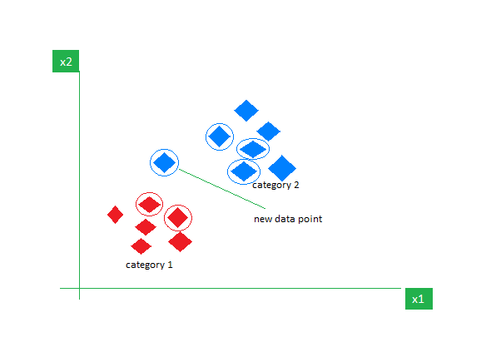
l
A
r
o
i
m
h
g
t
K-Nearest Neighbors (KNN) Algorithm
It works by finding the 'k' nearest data points (neighbors) in the feature space and making predictions based on the majority class (classification) or average (regression) of those neighbors.
36

Slide 41
l
A
r
o
i
m
h
g
t
K-Nearest Neighbors (KNN) Algorithm
How It Works:
Choose a value for K (e.g., 3, 5, etc.)
For a new input, measure distance (commonly Euclidean) to all other points
Select K closest neighbors
For classification: Majority vote
For regression: Average value
37

Slide 42
l
A
r
o
i
m
h
g
t
K-Nearest Neighbors (KNN) Algorithm
Advantages:
Simple and easy to understand.
Non-parametric, meaning it makes no assumption about the underlying data distribution.
Limitations:
Computationally expensive for large datasets (needs to calculate distances for each query).
Sensitive to irrelevant features and the choice of distance metric.
38

Slide 43
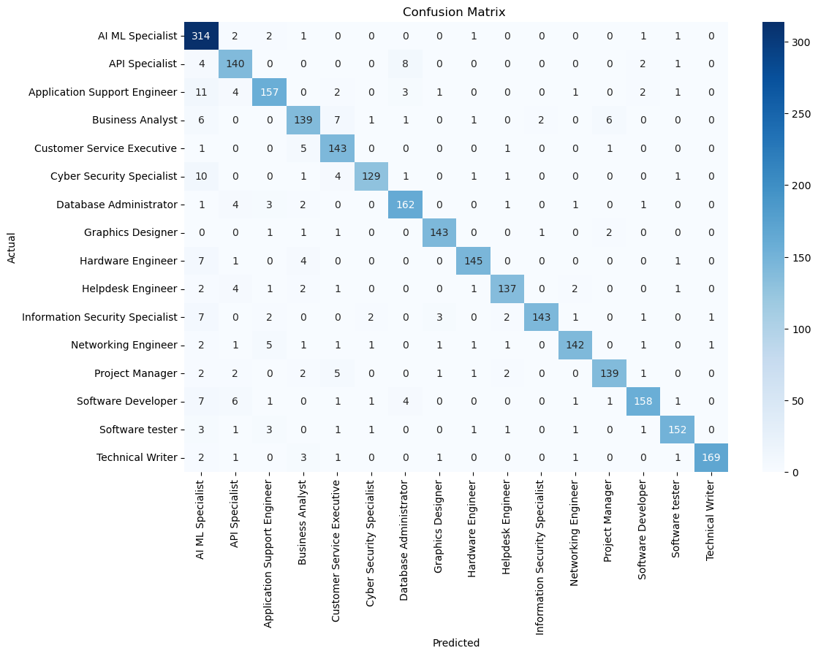
l
A
r
o
i
m
h
g
t
K-Nearest Neighbors (KNN) Algorithm
39

Slide 44
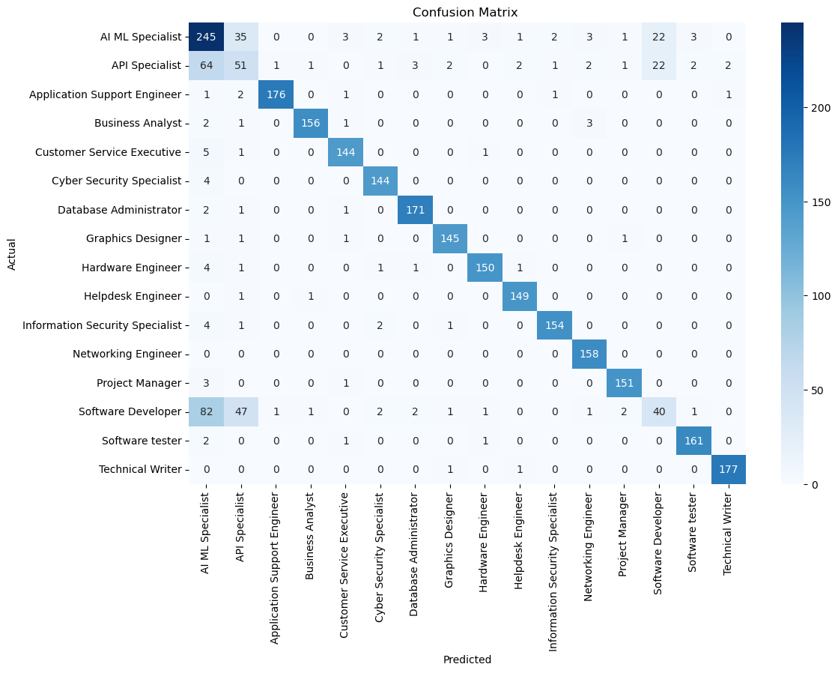
l
A
r
o
i
m
h
g
t
Support Vector Machine Algorithm
40

Slide 45
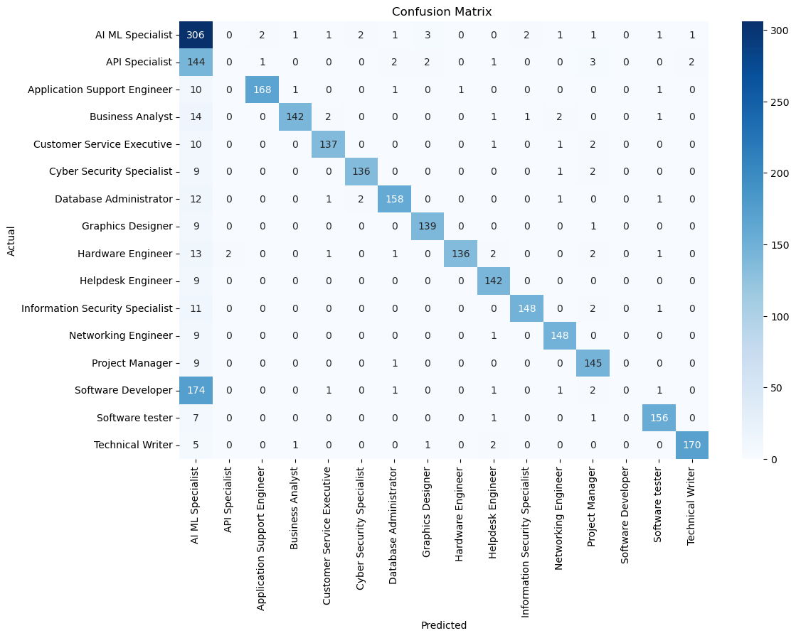
l
A
r
o
i
m
h
g
t
Random Forest Algorithm
41

Slide 46
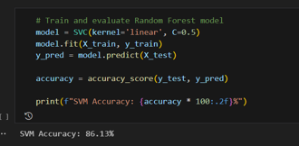
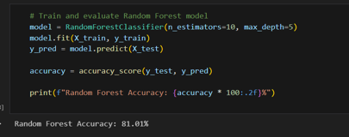
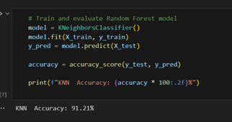
l
A
r
o
i
m
h
g
t
Accuracy Comparison
Support Vector Machine
Random Forest
KNN
42

Slide 47
l
A
r
o
i
m
h
g
t
Accuracy Comparison
ALGORITHM | ACCURACY
Decision Tree | 91.21%
Support Vector Machine | 86.13%
Random Forest | 81.01%
43

Slide 48
Interfaces and Codes.
44

Slide 49

45

Slide 50
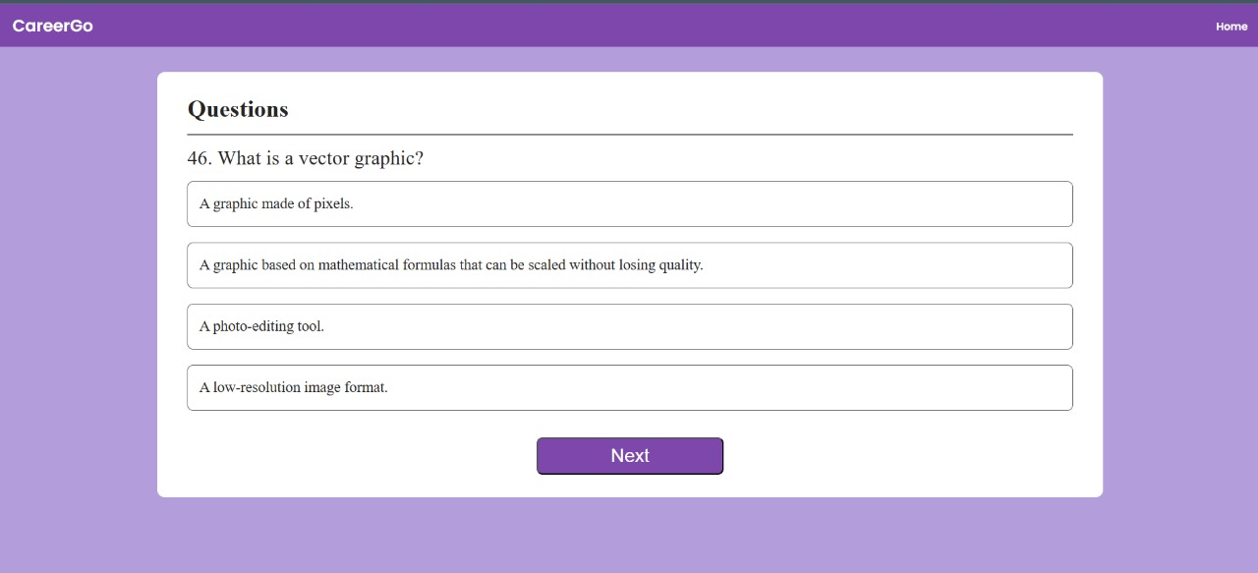
46

Slide 51
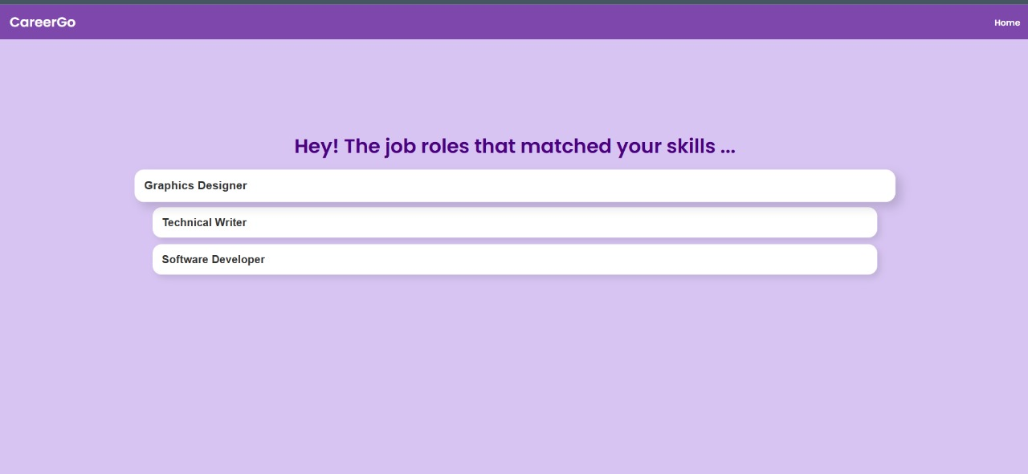
47

Slide 52
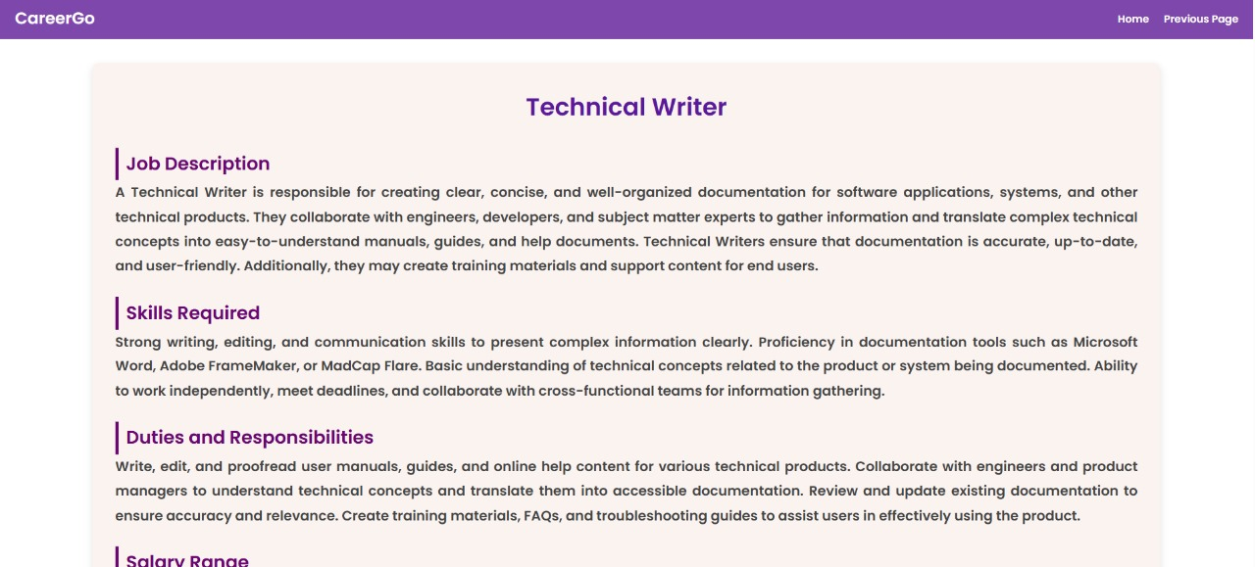
48

Slide 53
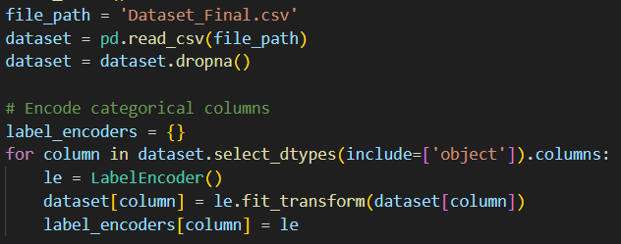
MODEL
49

Slide 54
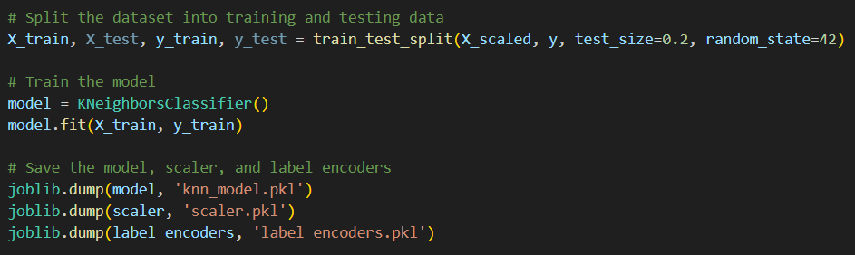
MODEL
50

Slide 55
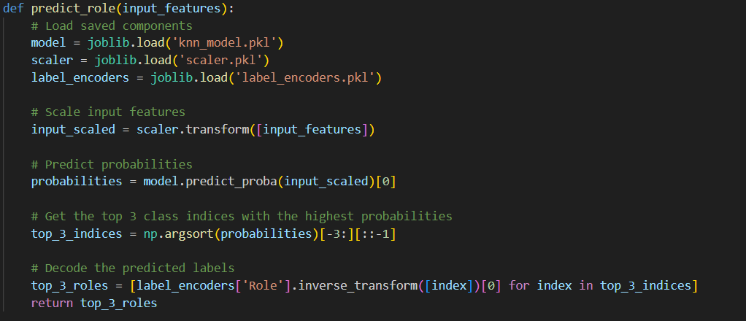
MODEL
51

Slide 56
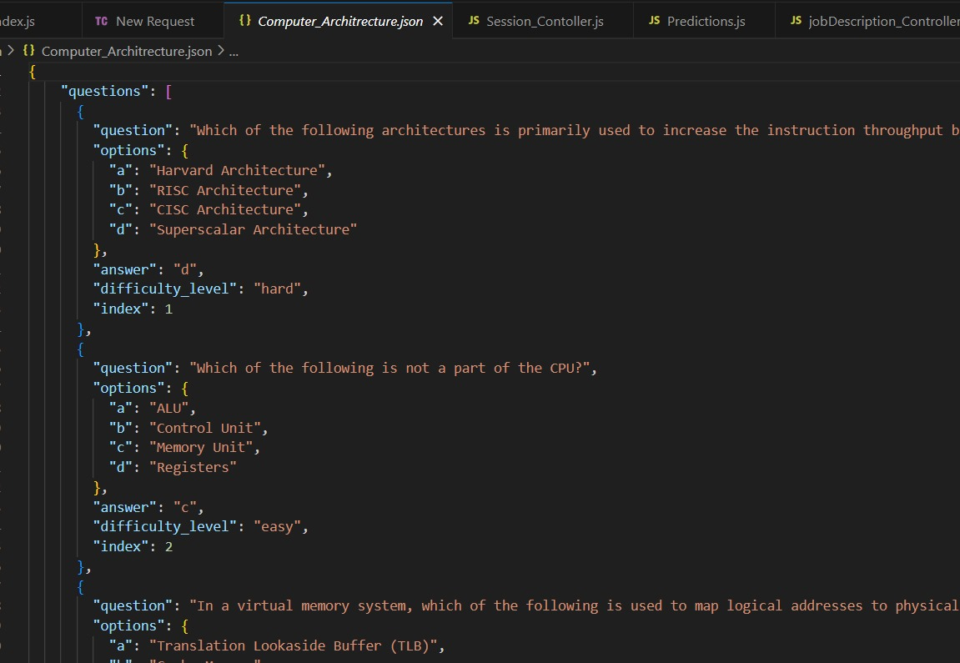
BACKEND
53

Slide 57
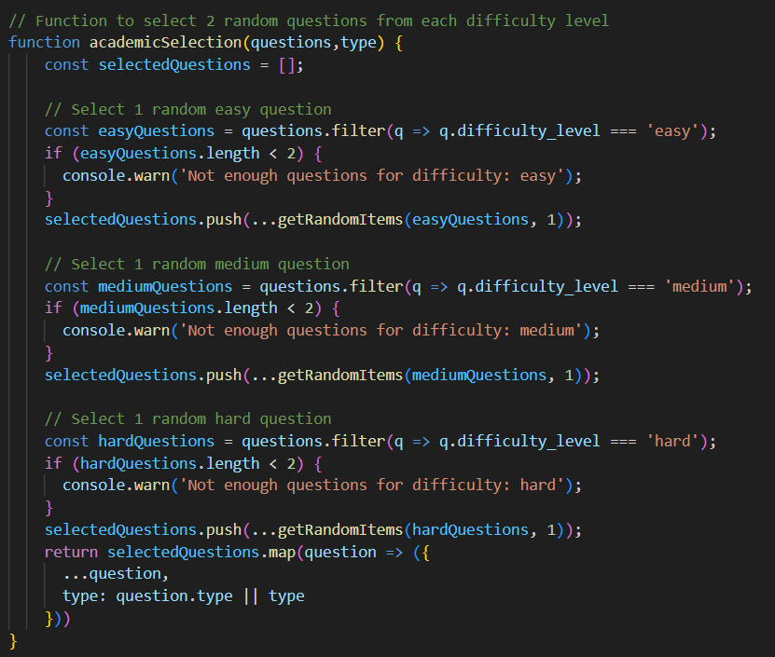
BACKEND
54

Slide 58
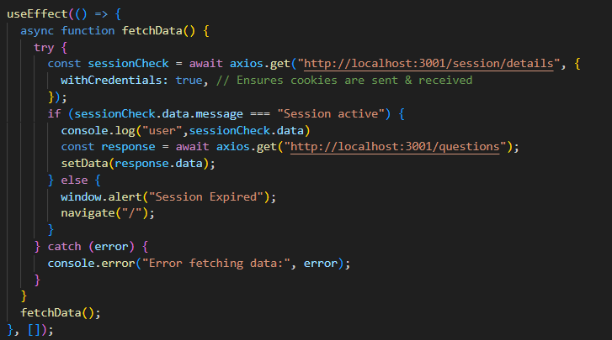
FRONTEND
55

Slide 59
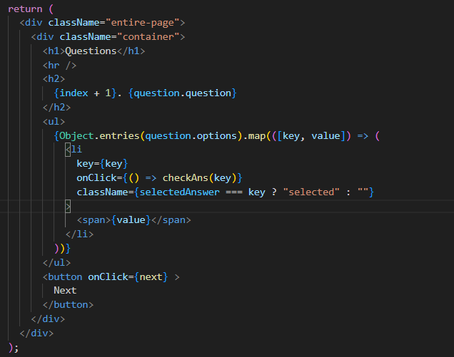
FRONTEND
56

Slide 60
C
c
o
n
n
l
s
i
u
o
The automatic career recommendation website uses machine learning to give personalized career advice based on user questionnaires
It analyzes user preferences and skills to suggest careers that match their profile
This approach improves career counseling by providing accurate, data-based recommendations to help users make better career choices at the comfort of their home
57

Slide 61
R
e
e
r
f
e
e
n
c
An Intelligent Career Guidance System using Machine Learning Dahanke Ajay, Shinde Nilesh, Dhagate Anirudh, Shaikh Huzaif International Research Journal of Engineering and Technology (IRJET) Volume: 09 Issue: 03 | Mar 2022
Development of a Web-based Intelligent Career Guidance System for Pre-Tertiary Science Students in Nigeria by Alao Kazeem A. and Bolarinwa Ismaila A. Circulation in Computer Science Vol.2, No.8, pp: (4-17), September 2017 https://doi.org/10.22632/ccs-2017-252-51
Online Career Counsellor System based on Artificial Intelligence: An Approach by Kartikey Joshi and Amit Kumar Goel 2020 7th International Conference on Smart Structures and Systems (ICSSS) DOI:10.1109/ICSSS49621.2020.9202024
57

Slide 62
R
e
e
r
f
e
e
n
c
A Survey on Machine Learning Approaches and Its Techniques by Thomas. Rincy. N and Dr. Roopam Gupta 2020 IEEE International Students' Conference on Electrical,Electronics and Computer Science (SCEECS) 07 May 2020 DOI: 10.1109/SCEECS48394.2020.190
A Study of Data Mining Methods for Prediction of Personality Traits by Helly. N. Desai and Prof. Rakesh Patel 2020 International Conference on Smart Electronics and Communication (ICOSEC) 07 October 2020 DOI: 10.1109/ICOSEC49089.2020.9215379
Applicability Analysis of the Combination of Career Anchors and Big-Five Personality for Student Career Development by Tomoya Mizubuchi and Toshihiko Hamasaki 2020 IEEE International Conference on Teaching, Assessment, and Learning for Engineering (TALE) December 2020 DOI:10.1109/TALE48869.2020.9368474
58

Slide 63
R
e
e
r
f
e
e
n
c
Automated Career Guidance using Graphology, Aptitude Test and Personality Test by Apoorva Anand , Mrs. Dhanashri Patil and Shivani Bhagwat 2018 Fourth International Conference on Computing Communication Control and Automation (ICCUBEA) 25 April 2019 DOI 10.1109/ICCUBEA.2018.8697642
Personality Classification System using Data Mining by Sandhya Katiyar and Himdweep Walia 2020 8th International Conference on Reliability, Infocom Technologies and Optimization (Trends and Future Directions) (ICRITO) 15 September 2020 DOI:10.1109/ICRITO48877.2020.9197803
Student Career Prediction Using Advanced Machine Learning Techniques K.Roopkanth,K. Sripath Roy,V.Uday Teja April 2018 International Journal of Engineering & Technology 7(2):26 DOI:10.14419/ijet.v7i2.20.11738
59

Slide 64
R
e
e
r
f
e
e
n
c
A Probabilistic Machine Learning Approach for Eligible Candidate Selection , Marium-E-Jannat ,Sayma Sultana Chowdhury ,Munira Akther International Journal of Computer Applications (0975 – 8887) Volume 144 – No.10, June 2016
CAREER GUIDANCE SYSTEM USING MACHINE LEARNING Sandeep Mishra ,Jash Sanghav,Hiren Patel International Journal Of Creative Research Thoughts (IJCRT) | Volume 9, Issue 5 May 2021 | ISSN: 2320-2882
A Machine Learning Approach for Future Career Planning Yu Lou,Ran Ren,Yiyang Zhao May 2024 International Journal of Innovative Research in Computer and Communication Engineering 12(05):5602-5609 DOI: 10.15680/IJIRCCE.2024.1205079
60

Slide 65
R
e
e
r
f
e
e
n
c
Creating Crowd Variation with the OCEAN Personality Model Funda Durupınar,Jan Allbeck January 2008 DOI:10.1145/1402821.1402835 Conference: 7th International Joint Conference on Autonomous Agents and Multiagent Systems (AAMAS 2008), Estoril, Portugal, May 12-16, 2008, Volume 3
Map My Career: Career Planning Tool to Improve Student Satisfaction SARATH TOMY,ERIC PARDEDE September 2019 IEEE Access PP(99):1-1 DOI:10.1109/ACCESS.2019.2940986
Personalized Career-Path Recommendation Model for Information Technology Students in Indonesia PUJI CATUR SISWIPRAPTINI,HARCO LESLIE March 2024 IEEE Access PP(99):1-1 DOI: 10.1109/ACCESS.2024.3381032
61

Slide 66
THANK YOU.

Slide 67
Q
&
A

